Slide 1
Radio Frequency Readout Device (RFRD)
May 1718 RFRD

Slide 2
Team Members Clients
Brandon Baxter – Leader, IC Team
Vaughn Dorsey –Webmaster, Reader Team
Luke Myers –Communication Leader, IC Team
Kurt Turner –Key Concept Holder, IC Team
Aaron Haywood – Antenna Team
Robert Buckley – Reader Team
Mehdy Faik – Antenna Team
Kellen Yoder – Reader Team
Michael Miller – IC Team
Primary Advisor/Client:
Dr. Qiao
Secondary Advisor:
Dr. Song
Notes:
Slide 2:
Everyone?

Slide 3
Purpose / Background
Multi-purpose Remote Readout Device
Specific Test Scenario: Street lamps across the U.S.
Each lamp
6 – 8 bolts
Thousands of lamps per state
Problem
Bolts become loose over time
There is a need for a method of detection of these loosened bolts
Notes:
Slide 3:
Brandon –
We have been tasked with creating an RFID-like system that can measure capacitance at a distance. The purpose of this system is due to

Slide 4
Specifications
Requirements
RF technology & Energy Siphoning → Create RF tag
Value changing readout RF device
RF tag Specs
Measure Washer Separation via Capacitance
Report Capacitance to Reader
Important Constraints
Power (Passive Tag)
Range (5 meter distance)
Cost (< $0.50 per Tag)
Notes:
Slide 4:
Luke -

Slide 5
Research
Findings
5 meter range → Suggests we neeed to use 900 MHz RF technology
Source 1: http://ieeexplore.ieee.org/document/6934233/
Source 2: http://ieeexplore.ieee.org/document/4396783/
Need a low power capacitance sensor
Need a state machine capable of changing output of a section of machine based on sensor data
Notes:
Slide 5:
Robert -

Slide 6
Project Roadblocks
Reader Team
900 MHz Technology
Cost prohibitive
Difficult to determine if high cost equipment implementation will be successful
Antenna Team
900 MHz outside our ability to test
Some simulation possible, but access to this equipment is not available to test properly
IC Team
Difficult to create designs with unknown available power details
Notes:
Slide 6:
Reader (Robert/Kellen/Vaughn) -
Antenna (Mehdy) –
IC (Kurt) -

Slide 7
New Approach
900 MHz → 13.56 MHz for Design
Reader Team
Design our own reader
More cost effective in early stages of design
Allow for switching back to 900 MHz to involve a simple parts switch
Antenna Team
13.56 MHz is a possible frequency for us to test with equipment available
IC Team
Initial data from Antenna Team detailing amount of power we have → Started on a CMOS design
Notes:
Slide 7:
Brandon – Talk about Frequency switch
Reader

Slide 8
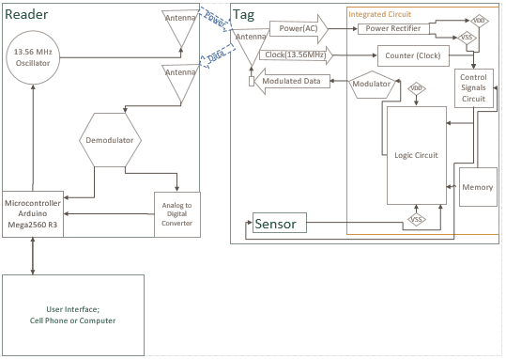
High Level of Entire System

Slide 9
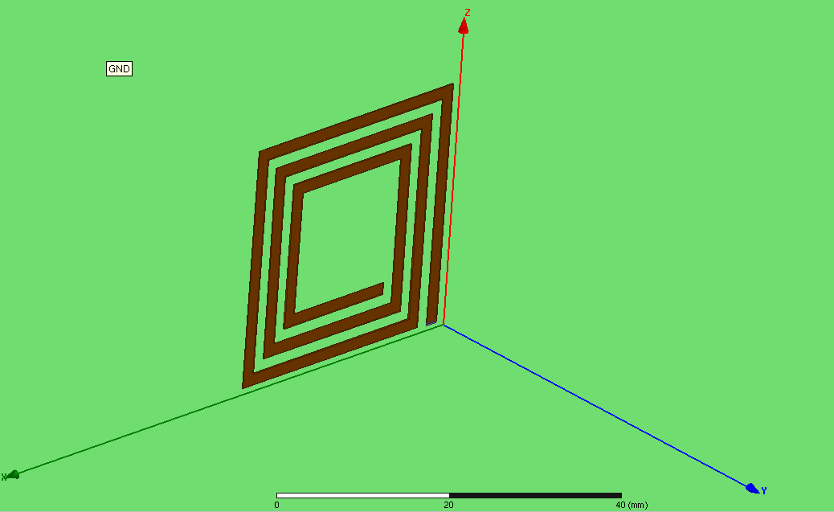
Current State: Antenna Team
Square Coil Antenna at 13.56 MHz
Optimal performance in breadboard tests
Logistics → Easier to implement
Design Variables
Trace Width & Thickness
Number of Segments
Footprint Size
Orientation
Presence of Dielectric
Notes:
Slide 8:
Mehdy -

Slide 10
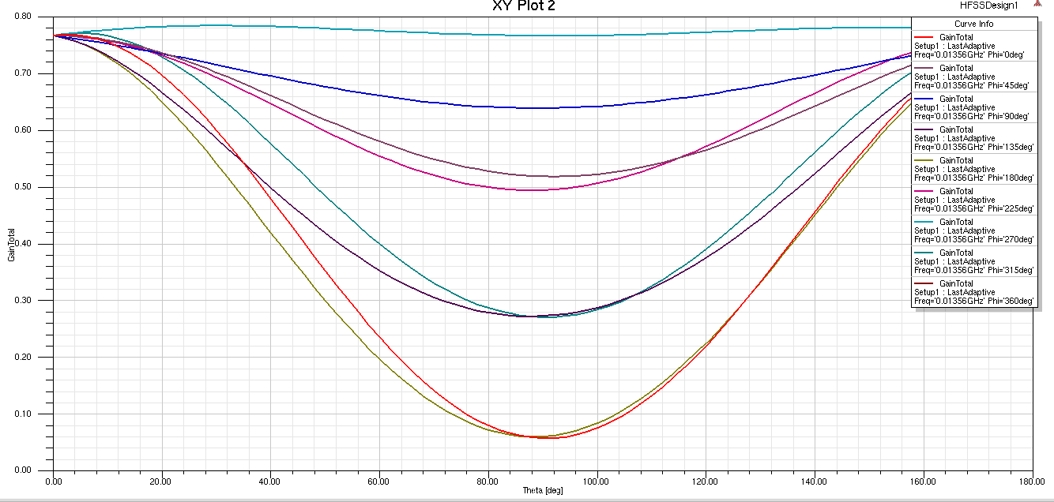
Current State: Antenna Team
Notes:
Slide 8:
Mehdy/Aaron -

Slide 11
Current State: Antenna Team
Gain Plot
Accounts for efficiency → Assumes source impedance match
Optimal Gain for φ = 270°
Power Received vs. Distance
100 mW Transmitted → Friis Transmission Equation
R (m) | 2 | 2.5 | 3 | 3.5 | 4 | 4.5 | 5
P_{r} (mW) | 44.70 | 28.61 | 19.86 | 14.59 | 11.17 | 8.829 | 7.151
Notes:
Slide 8:
Mehdy -
Question that may arise: What is the min and max power that is involved?

Slide 12
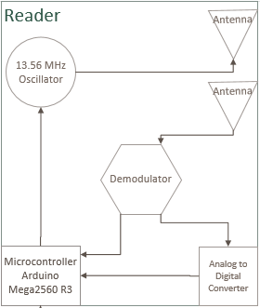
Current State: Reader Team
Parts have arrived → Reader design has begun
Issues with initial design have been found.
Oscillator does not work
Power Output to Antenna is too low.
Notes:
Slide 9:
Robert/Kellen – We recently ordered parts to create our first test version of our reader. We obtained parts two days before break, and found when we returned that our current design does not send enough power to the antenna. This has caused the range from tests to be very low, and we have not been able to receive a response from our test RFID tag. We are looking into different voltage controlled oscillators to improve the power to the antenna, and amplifiers if we cannot get enough from the oscillator.

Slide 13
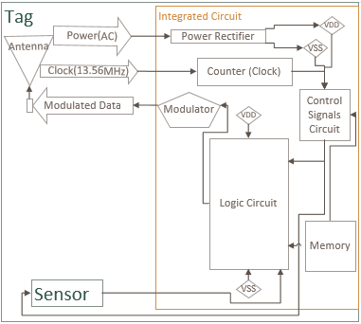
Current State: IC Team
Logic Circuit
Component Experimentation
Notes:
Slide 10:
Michael -

Slide 14
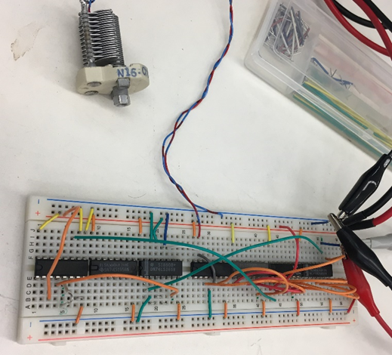
Current State: IC Team Prototype
Discrete Component Prototyping
Problems with high frequency noise

Slide 15
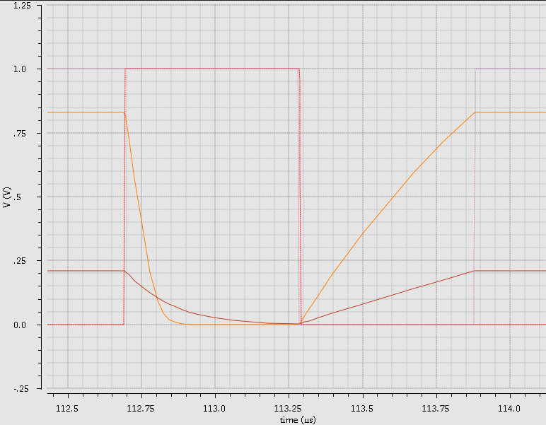
Current State: Capacitance Sensor
Capacitance sensor is working in simulations
Transition Graph
Discharge to reset
Charge to sensor value
Notes:
Slide 11:
Kurt -

Slide 16
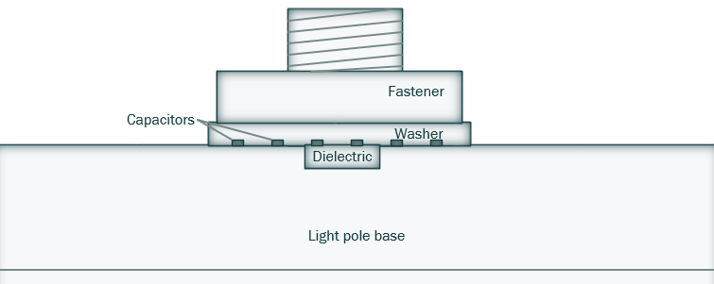
Current State: Loose/Tight
Pre tightened
Torqued to spec
Loosened over time
Dielectric in base material
Notes:
Slide 12:
Brandon/Luke –
Vaughn – App Design

Slide 17
Looking Forward
Order more parts for improvements on working prototype
Improve simulation models for both IC and Antenna Teams
Redesigning current reader → Test
Eventually move design of Reader a PCB
Development of user interface app design
Notes:
Slide 12:
Brandon/Luke –
Vaughn – App Design

Slide 18
Questions?

Slide 19
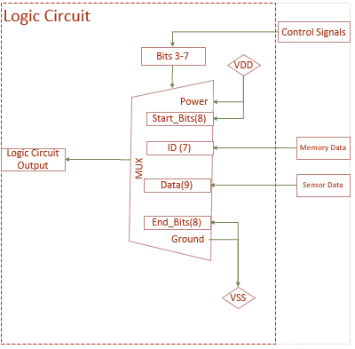
Logic Circuit Design

Slide 20
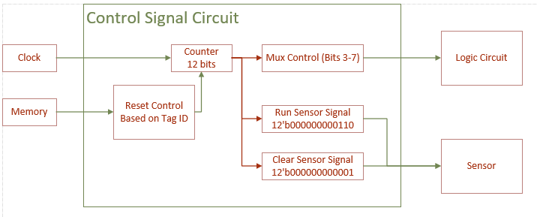
Control Signals Design

Slide 21
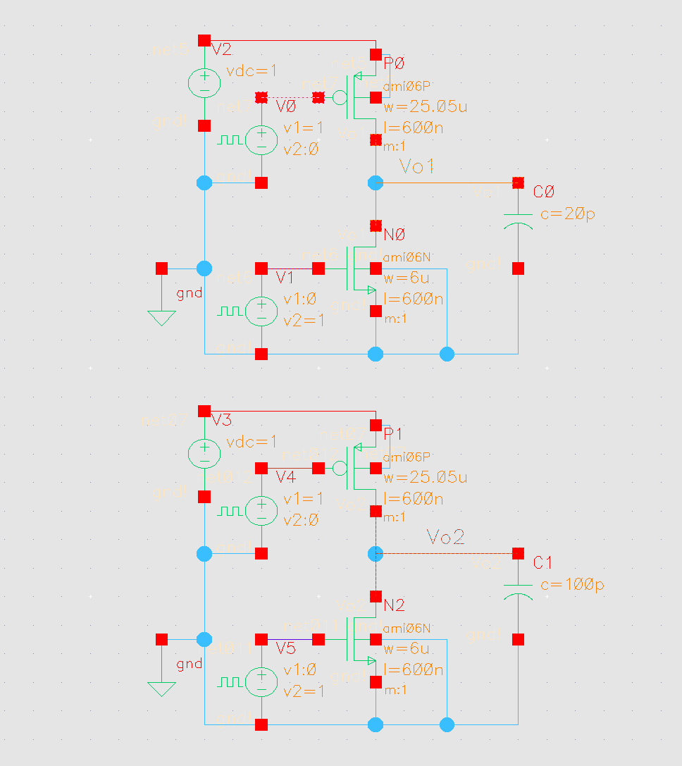
Sensor Testing
Simulating capacitor charging/discharging

